Slide 1
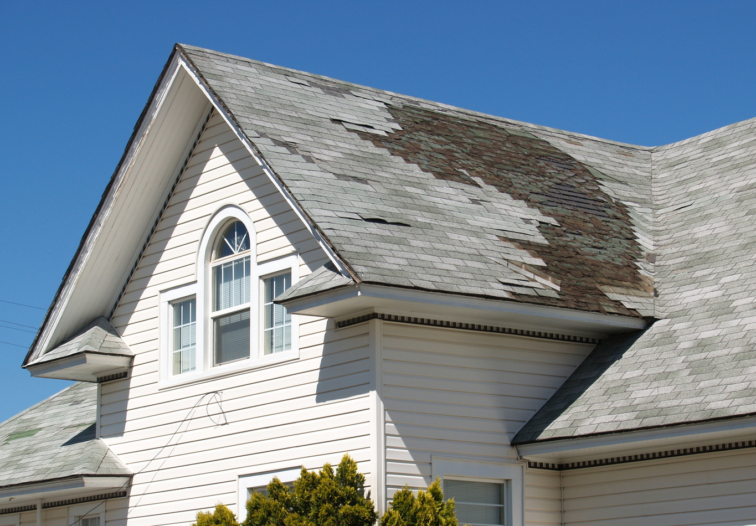

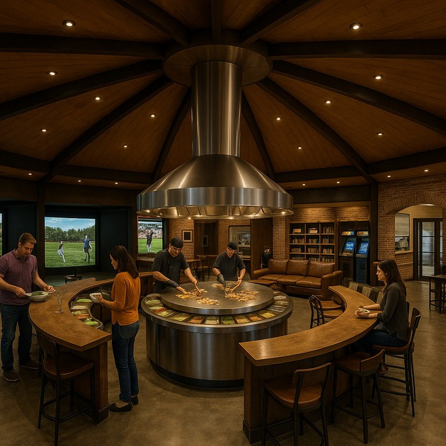
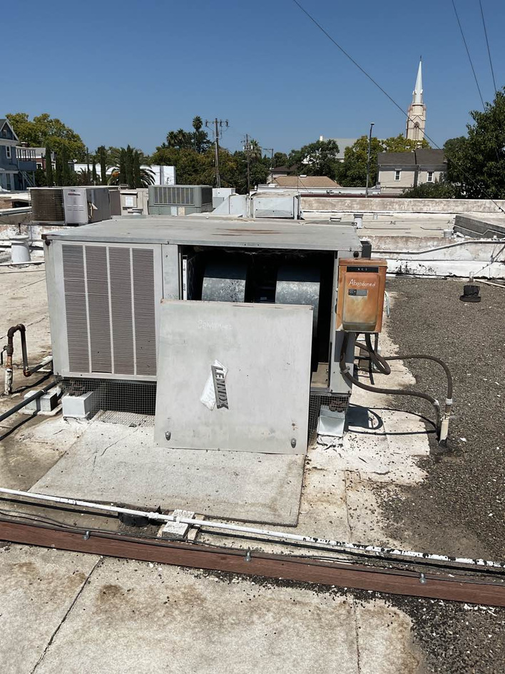





INTRODUCING OUR NEW SERVICES
HOME INSPECTIONS • HOME HEALTH REPORTS
VIRTUAL TOURS • FACILITY CONDITION ASSESSMENTS
Craig McBride
530-588-9366
www.4jcon.com

Slide 2




WHO WE ARE
OUR FOUNDATION:
SERVICE, INTEGRITY, FAMILY, FAITH
20+ YEARS OF CONSTRUCTION EXCELLENCE
STRONG CORE VALUES DRIVE EVERY PROJECT
TRUSTED BY DEVELOPERS, SCHOOLS, BUSINESSES, AND PROPERTY OWNERS
www.4jcon.com
Notes:
We’ve built our reputation not just on projects, but on principles: Service, Integrity, Family, and Faith. These values shape how we do business and why clients trust us. Now, we’re expanding our expertise to offer services that go beyond construction management — services that protect investments, reduce risks, and add transparency

Slide 3
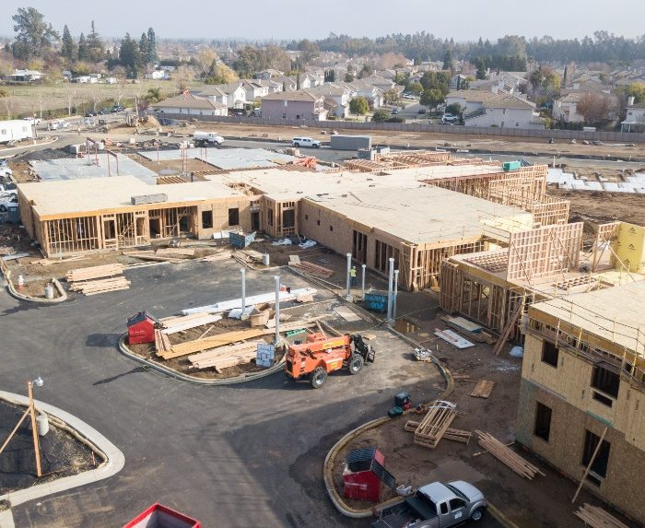
WHY WE’RE EXPANDING
MEETING CLIENT NEEDS BEYOND CONSTRUCTION
CLIENTS WANT CONFIDENCE AT EVERY STAGE OF OWNERSHIP
FACILITIES REQUIRE LONG-TERM PLANNING, NOT JUST BUILDS
TECHNOLOGY NOW ENABLES SMARTER TRANSPARENCY
www.4jcon.com
Notes:
Our clients told us they need more than construction. They need data, insight, and tools that protect their investment. Whether it’s understanding a home’s condition, forecasting a facility’s future costs, or showcasing a property to stakeholders, these services close the gap between construction and ownership

Slide 4
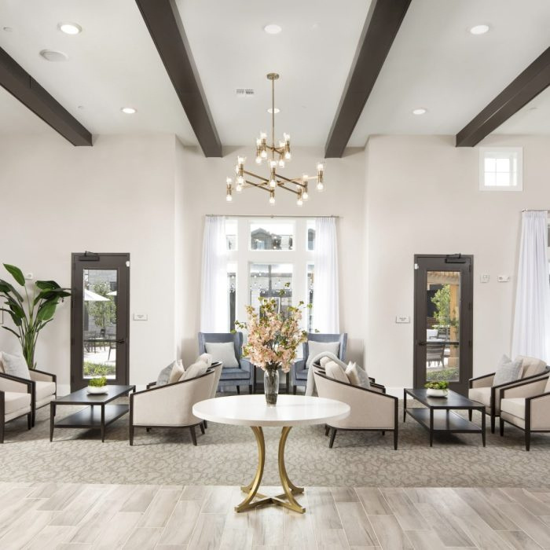


HOME INSPECTIONS
COMPREHENSIVE HOME INSPECTIONS
DETAILED EVALUATIONS FOR BUYERS, SELLERS, OWNERS & INSURANCE COMPANIES
STRUCTURAL, MECHANICAL, AND SAFETY REVIEW
IDENTIFIES CURRENT AND FUTURE ISSUES WITH THE PROPERTY
www.4jcon.com
Notes:
“Buying or selling a property is one of the biggest financial decisions you’ll make. Our Home Inspections give clients confidence by uncovering hidden issues before they become expensive. With over two decades of hands-on construction experience, we know exactly what to look for — from foundations to roofing, from plumbing to electrical systems.”
“The value? Peace of mind and negotiation power.”

Slide 5
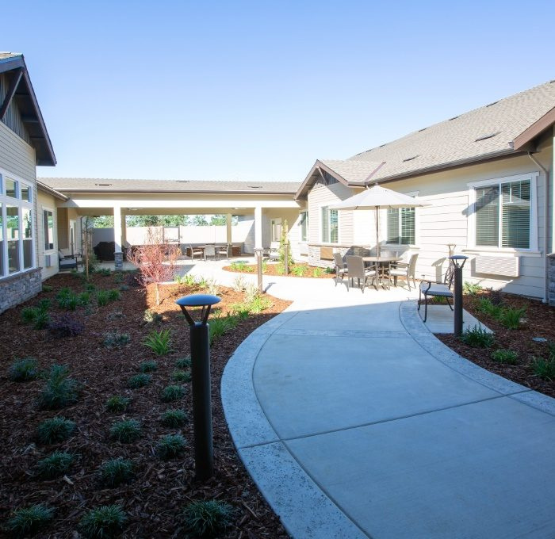
HOME HEALTH REPORTS
A COMPLETE HEALTH CHECK
FOR YOUR PROPERTY
GOES BEYOND STANDARD INSPECTIONS
ENERGY, SAFETY, AND MAINTENANCE ANALYSIS
ACTIONABLE RECOMMENDATIONS FOR REPAIRS, AND MAINTENANCE.
Sample Home Health Report
www.4jcon.com
Notes:
“Our Home Health Reports are like a medical check-up — but for your property. Instead of just listing problems, we provide a detailed roadmap to keep your home safe, efficient, and valuable.”
“We help homeowners prioritize repairs, spot efficiency upgrades, and budget with confidence. The value is long-term: lower costs, safer living, and a stronger return on investment.”

Slide 6


HOME HEALTH REPORT
SAMPLE REPORT
Property Address
8769 Dyer Rd.
Salinas, CA 93907
Client Name
Bob Einstein
Client Contact Information
Bob@gmail.com
800-444-4444
Date of Inspection
2025-08-23T00:00:00-07:00
www.4jcon.com
Notes:
“Our Home Health Reports are like a medical check-up — but for your property. Instead of just listing problems, we provide a detailed roadmap to keep your home safe, efficient, and valuable.”
“We help homeowners prioritize repairs, spot efficiency upgrades, and budget with confidence. The value is long-term: lower costs, safer living, and a stronger return on investment.”

Slide 7
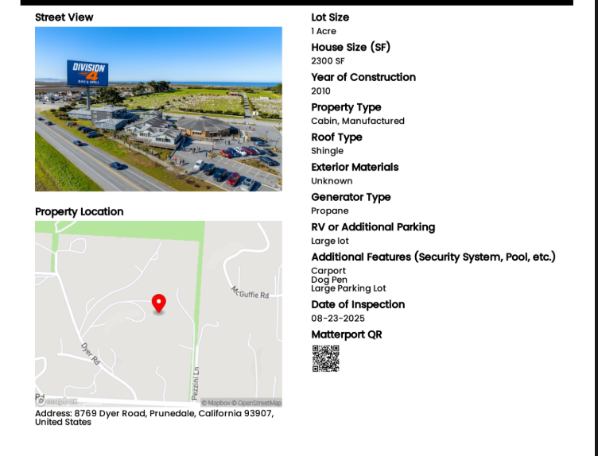
EXECUTIVE SUMMARY
PROPERTY INFORMATION
  Foundation & systems in good condition
  Roofing shingles = poor condition
  Plumbing drain lines need replacement
  Trees overgrown – maintenance needed
REPORT LIMITATIONS
  Inspection is visual and non-invasive; not technically exhaustive.
  Hidden areas (walls, underground, behind furniture) not inspected.
  Engineering, code compliance, and repair cost estimates excluded.
  Environmental hazards (mold, asbestos, lead, radon, pests, pools, security, etc.) not covered unless noted.
  Testing limited to normal homeowner controls (no dismantling, no pilot lights, no shut-off valves).
  Report reflects conditions on day of inspection only; no warranty provided.
  Clients should consult specialists for further evaluation when issues or aging systems are identified.
Notes:
“Our Home Health Reports are like a medical check-up — but for your property. Instead of just listing problems, we provide a detailed roadmap to keep your home safe, efficient, and valuable.”
“We help homeowners prioritize repairs, spot efficiency upgrades, and budget with confidence. The value is long-term: lower costs, safer living, and a stronger return on investment.”

Slide 8
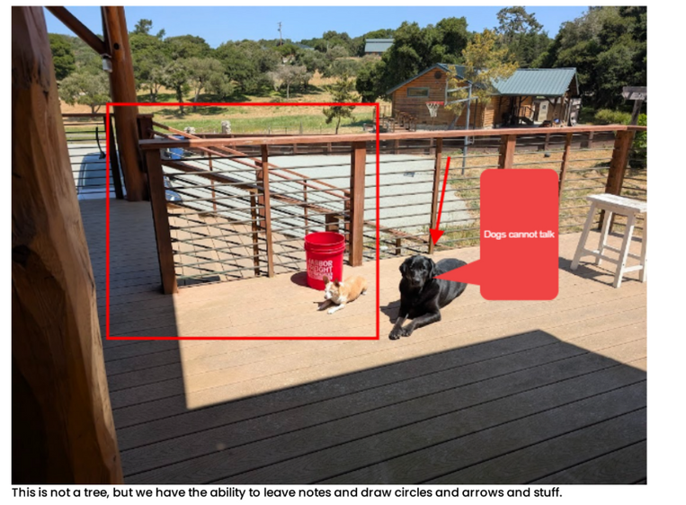
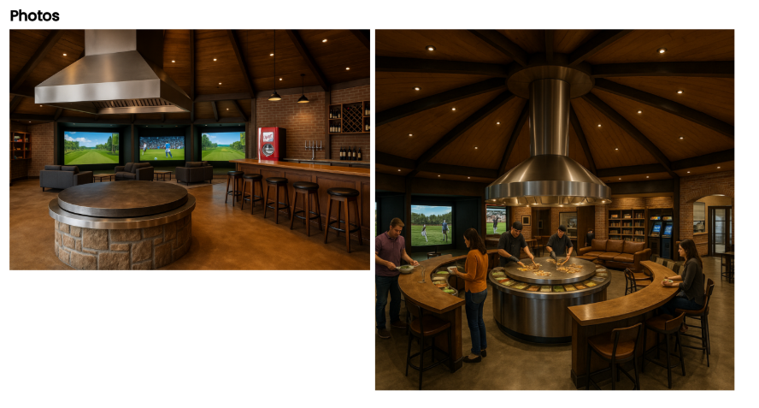
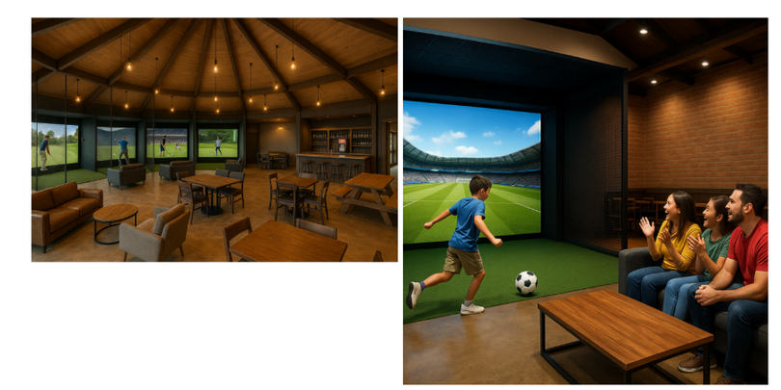
1. LOT ASSESSMENT
Decks/Porches/Railings = good condition
Grading and Drainage = adequate
Vegetation = overgrown (requires trimming)
Driveways/Walkways/Patios = good condition
2. STRUCTURAL COMPONENTS
Foundation = good condition
Floors = poor (not enough video games
Exterior Walls = good condition
Interior Walls = poor condition
Ceilings = good condition
Crawlspace = good shape
Exterior Doors = good condition
Windows = good condition
Notes:
“Our Home Health Reports are like a medical check-up — but for your property. Instead of just listing problems, we provide a detailed roadmap to keep your home safe, efficient, and valuable.”
“We help homeowners prioritize repairs, spot efficiency upgrades, and budget with confidence. The value is long-term: lower costs, safer living, and a stronger return on investment.”

Slide 9
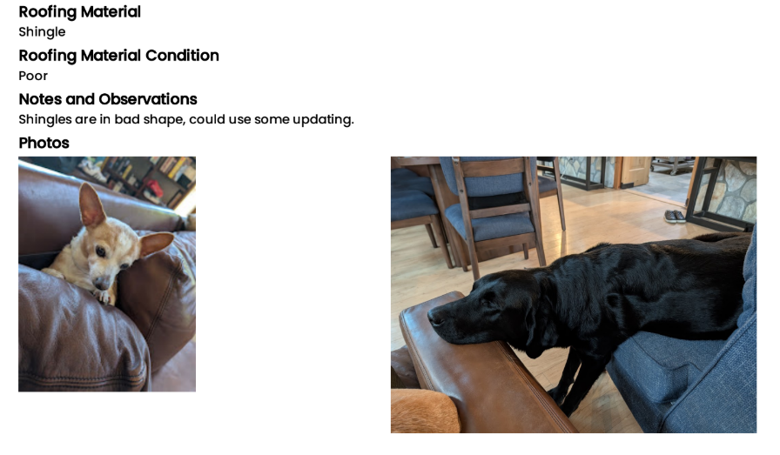
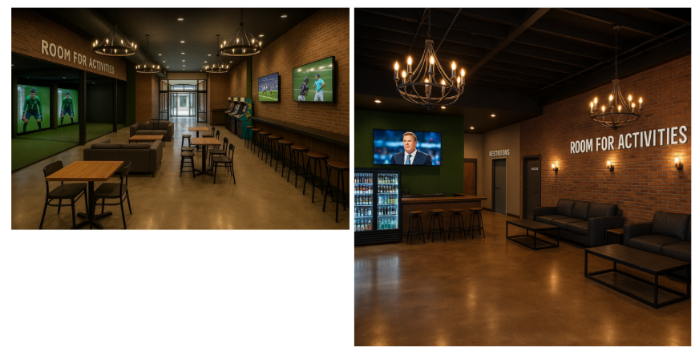
3. ROOFING
4. PLUMBING
Roofing Shingle = poor
Gutters/Downspouts = good condition
Flashing = good condition
Skylights/Chimneys/Roof Penetrations = good condition
Drain/Waste/Vent Lines = poor condition (replacement needed)
Fixtures and Faucets = good condition
Water Heater = good (suggested upgrade: tankless electric)
Pump/Sump Systems = good
5. ELECTRICAL
Service amperage: 220
Fixtures, Switches and Receptacles = good
Notes:
“Our Home Health Reports are like a medical check-up — but for your property. Instead of just listing problems, we provide a detailed roadmap to keep your home safe, efficient, and valuable.”
“We help homeowners prioritize repairs, spot efficiency upgrades, and budget with confidence. The value is long-term: lower costs, safer living, and a stronger return on investment.”

Slide 10
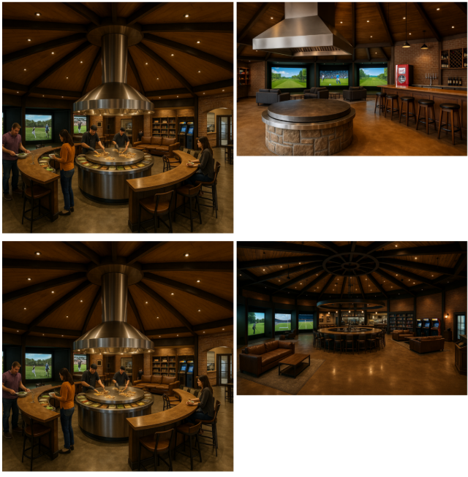
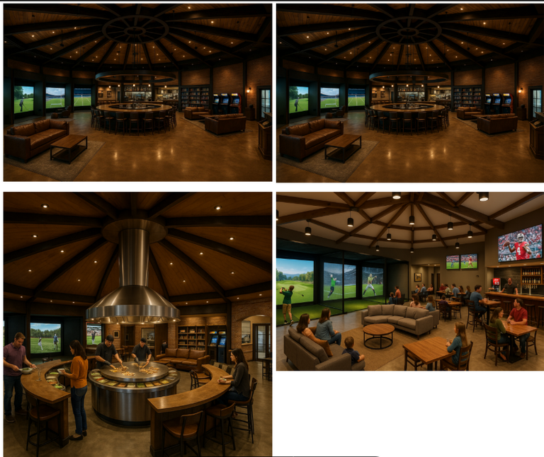
6.a HEATING
6.b AIR CONDITIONING
Propane Heating system = good
Electric AC Source = good
7. INTERIORS
Stairs and Railings = secure
Doors = good
Appliances operational (note: Mongolian grill detail)
Notes:
“Our Home Health Reports are like a medical check-up — but for your property. Instead of just listing problems, we provide a detailed roadmap to keep your home safe, efficient, and valuable.”
“We help homeowners prioritize repairs, spot efficiency upgrades, and budget with confidence. The value is long-term: lower costs, safer living, and a stronger return on investment.”

Slide 11
8. INSULATION AND VENTILATION
Attic insulation = fiberglass, 12 inches
Exhaust fans (kitchen, bath, laundry) = working
Dryer vent = good
9. FIREPLACES & FUEL BURNING APPLIANCES
Fireplace & chimney = good condition
CONCLUSION & RECOMMENDATIONS
  ROOFING & PLUMBING = PRIORITY FIXES
  OVERGROWN VEGETATION = SECONDARY MAINTENANCE
  OVERALL: STRUCTURE SOUND, SYSTEMS FUNCTIONAD CONDITION
Notes:
“Our Home Health Reports are like a medical check-up — but for your property. Instead of just listing problems, we provide a detailed roadmap to keep your home safe, efficient, and valuable.”
“We help homeowners prioritize repairs, spot efficiency upgrades, and budget with confidence. The value is long-term: lower costs, safer living, and a stronger return on investment.”

Slide 12
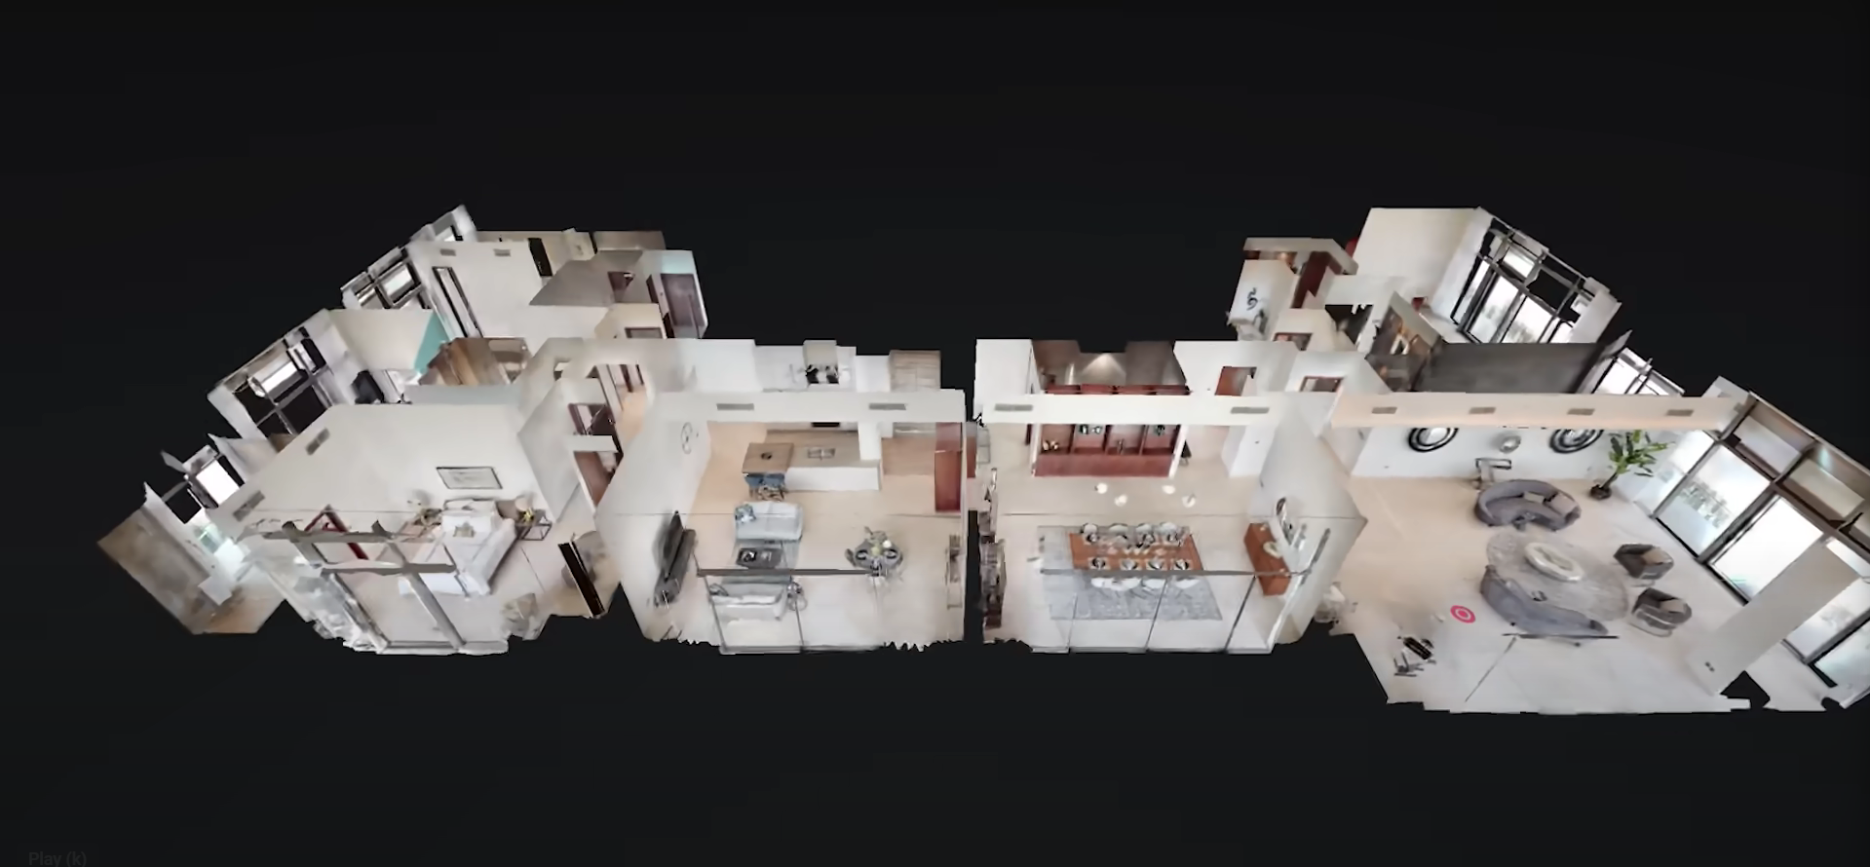
360 VIRTUAL TOURS
BRING PROPERTIES TO LIFE ONLINE
IMMERSIVE 360 VIRTUAL TOURS
ENGAGE BUYERS, TENANTS, AND INVESTORS
DOCUMENT CONSTRUCTION PROGRESS
www.4jcon.com
Notes:
“A photo shows part of a space. A virtual tour lets you step inside it. With Matterport 360° Virtual Tours, our clients can market properties, present to investors, and showcase projects as if the audience was physically there.”
“For real estate, it shortens sales cycles. For developers, it documents progress and builds trust. For schools and organizations, it increases transparency. The value is in engagement and clarity.”

Slide 13
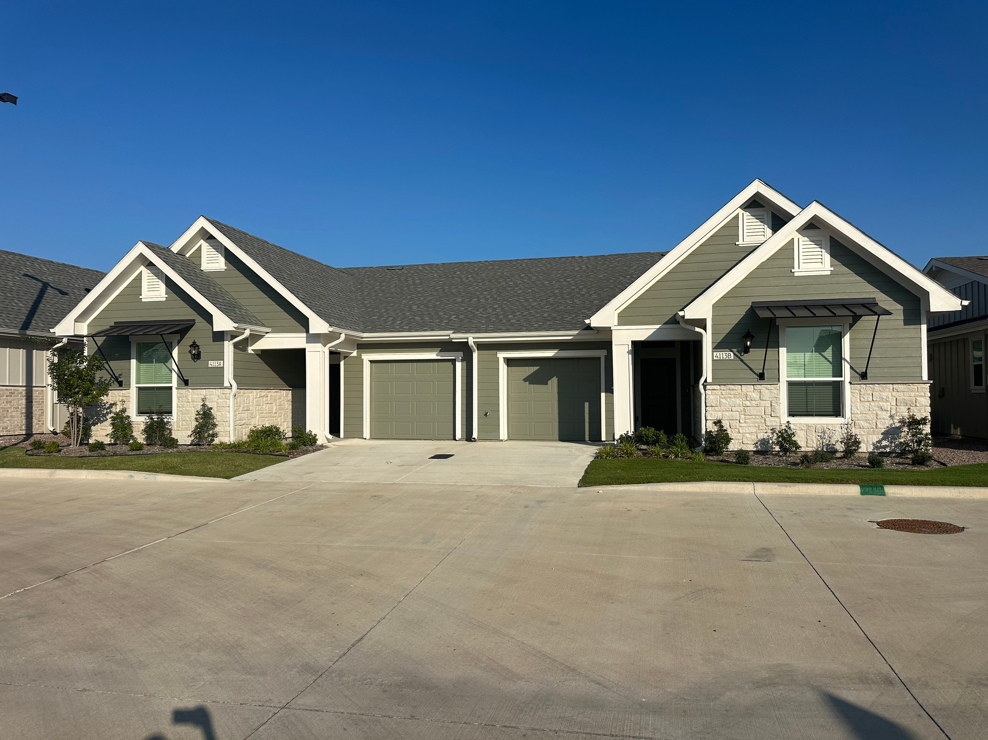

7233 Sherwood Mill Road

Slide 14
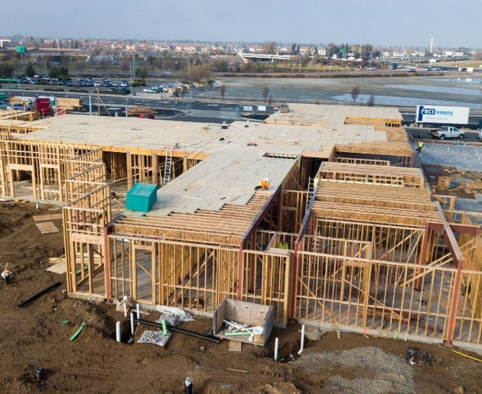
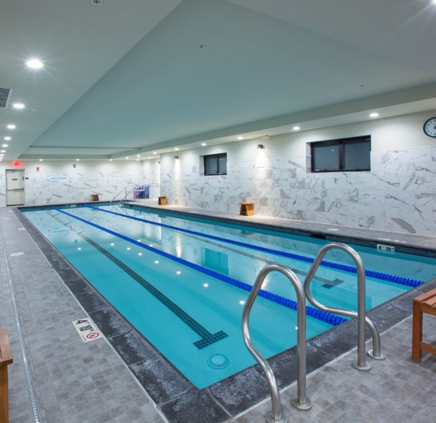
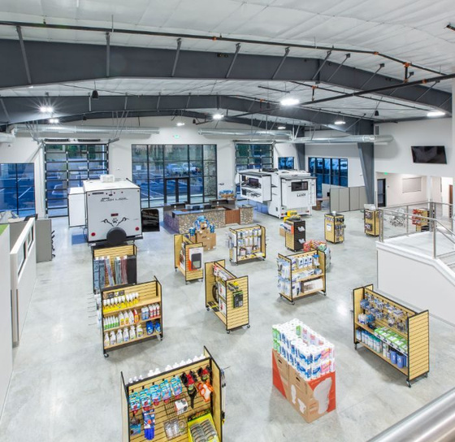
FACILITY CONDITION ASSESSMENTS
PLAN SMARTER WITH FACILITY CONDITION ASSESSMENTS
EVALUATES BUILDING SYSTEMS AND INFRASTRUCTURE
FoRECASTS MAINTENANCE COSTS AND LIFECYCLE NEEDS
SUPPORTS SMARTER CAPITAL PLANNING
Sample Facility Assessment Report
www.4jcon.com
Notes:
“Our Facility Condition Assessments give decision-makers the data they need to manage facilities effectively. We don’t just point out what’s broken — we forecast when systems will need repairs or replacement and estimate the costs.”
“The value? Smarter budgeting, reduced risks, and extended building life. This service is a game-changer for schools, government agencies, and organizations managing multiple properties.”

Slide 15
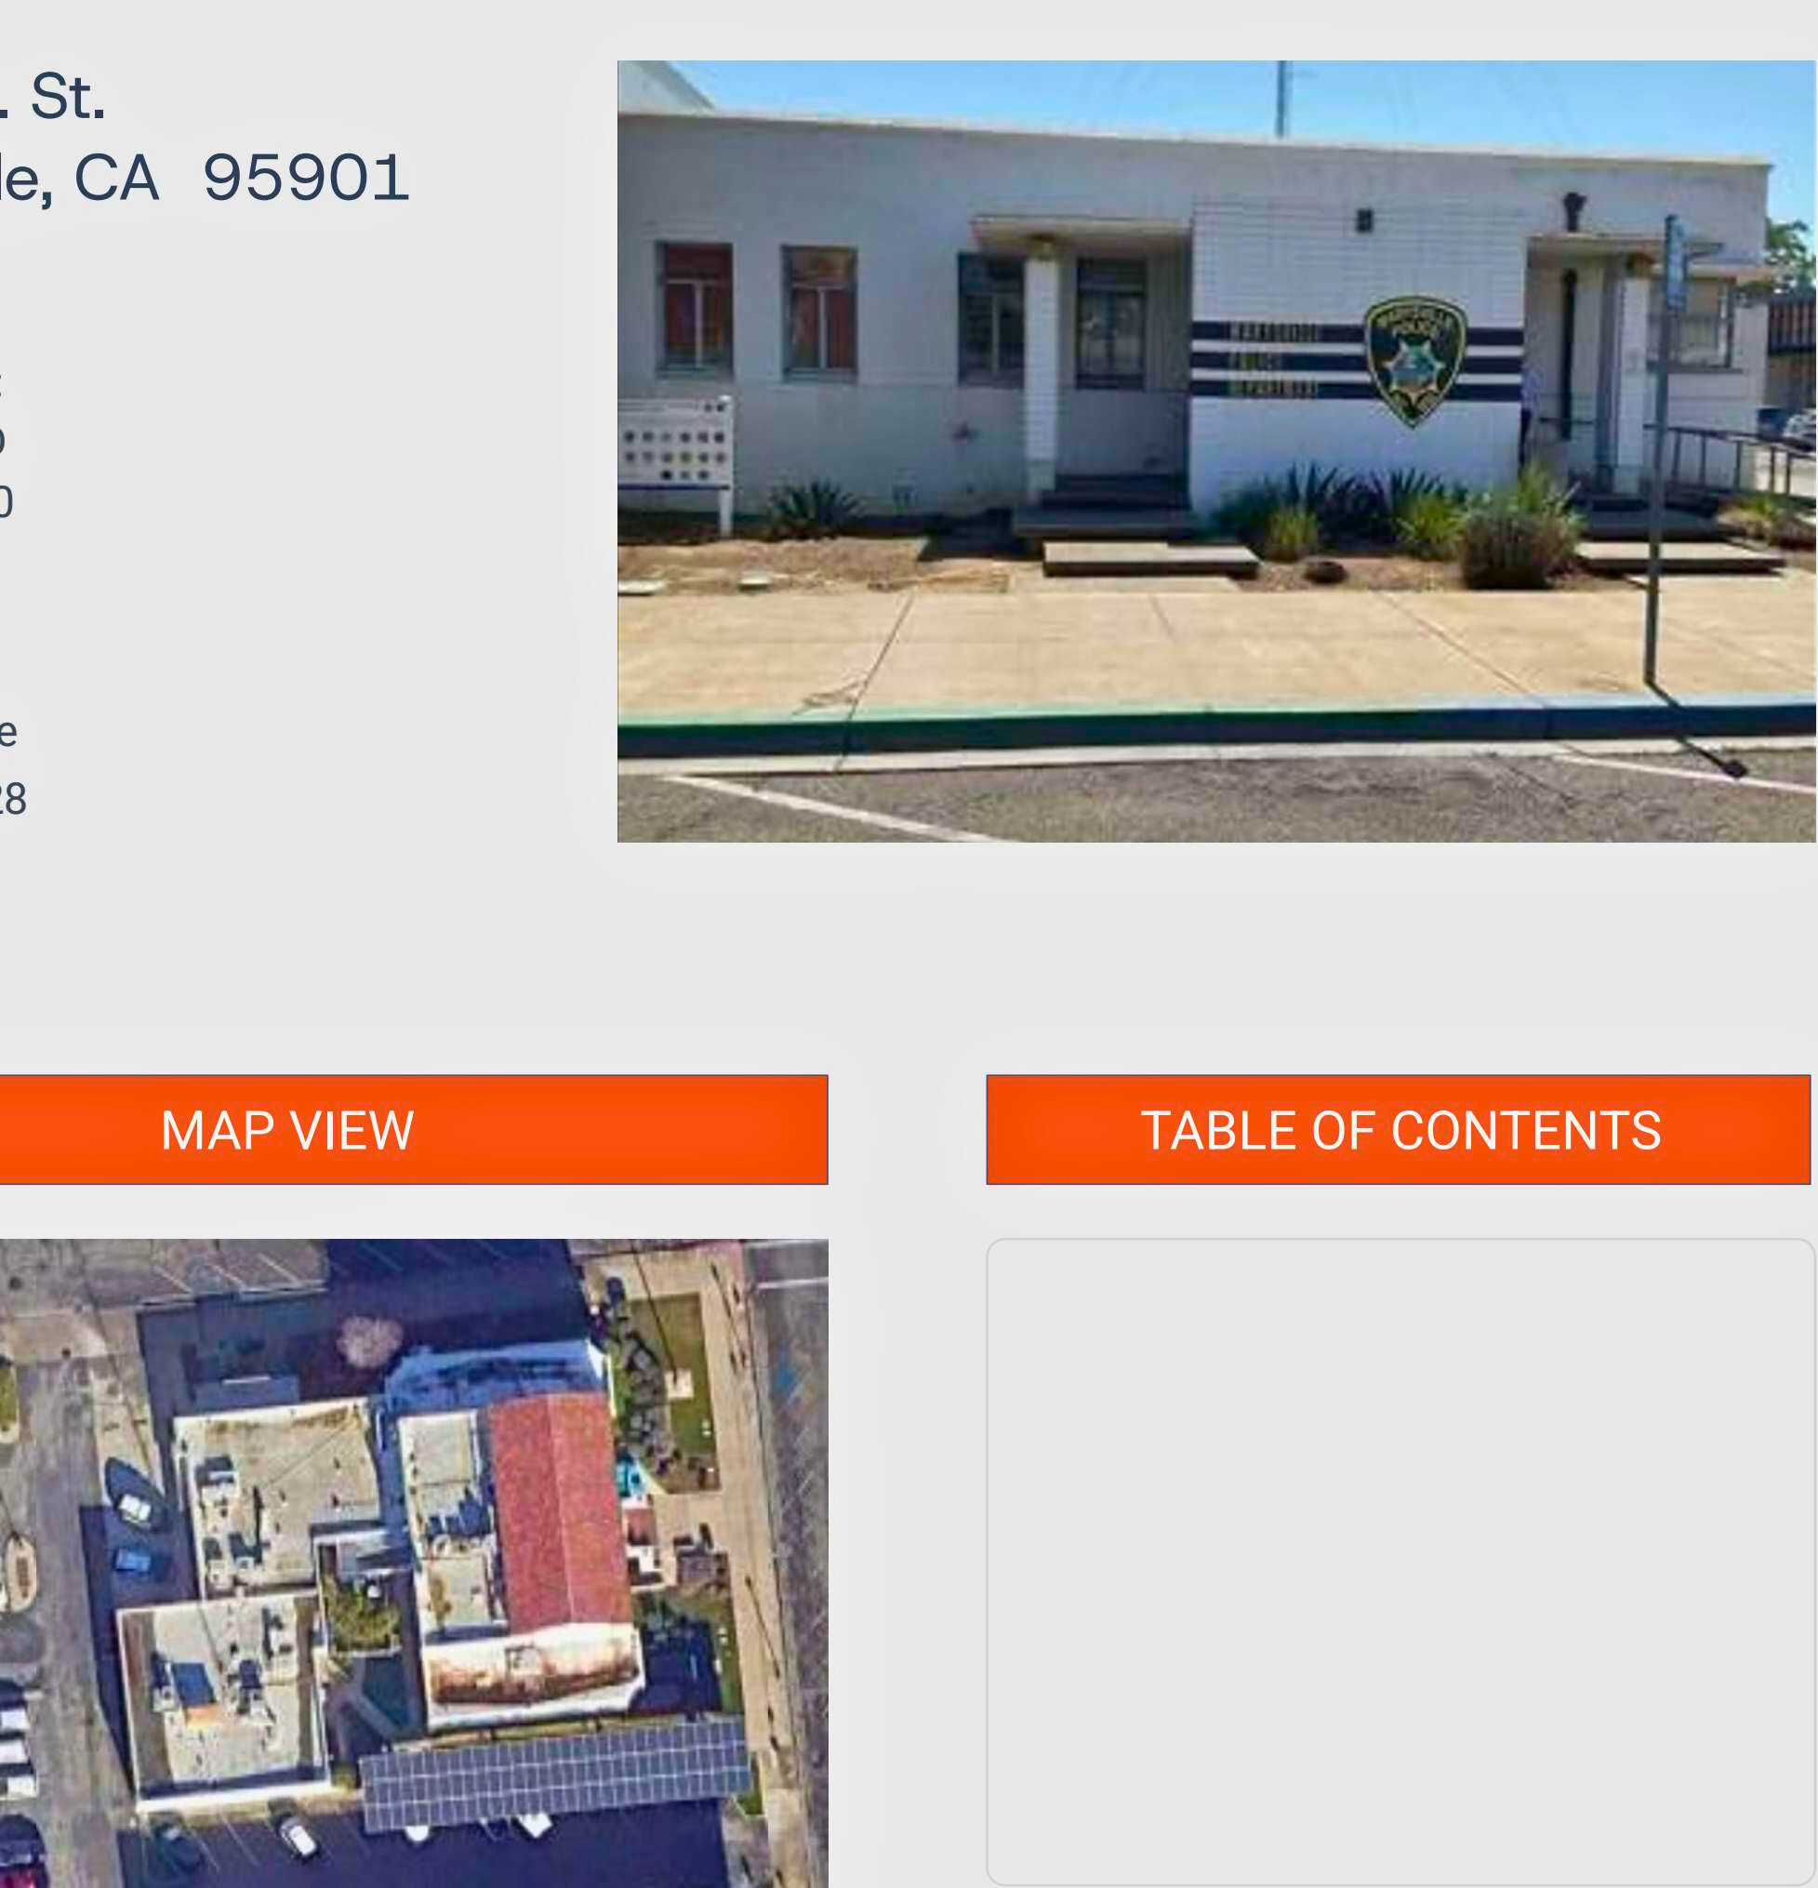
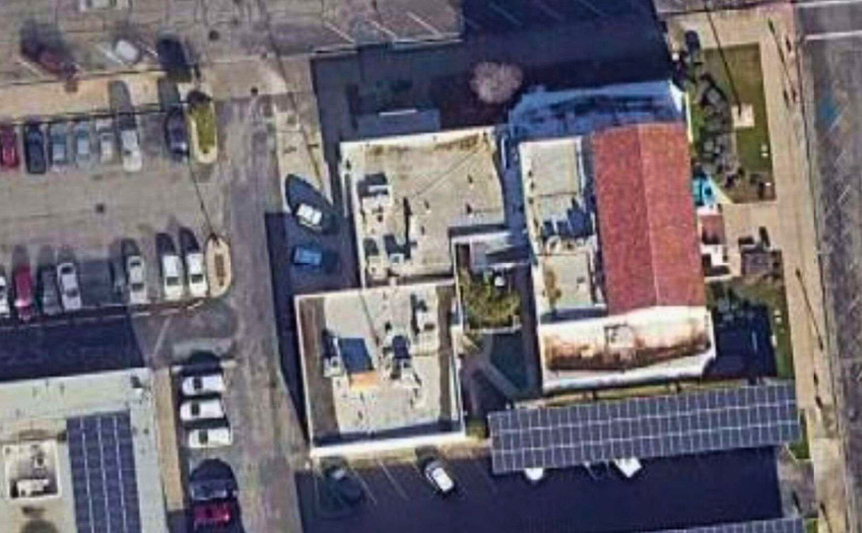
FACILITY ASSESSMENT REPORT
316 6th St, Marysville, CA 95901
SAMPLE PRESENTATION
Prepared for:
Marysville PD
530-749-3900
Inspector:
Craig Mcbride
Dated 8/25/28
www.4jcon.com
Notes:
“Our Home Health Reports are like a medical check-up — but for your property. Instead of just listing problems, we provide a detailed roadmap to keep your home safe, efficient, and valuable.”
“We help homeowners prioritize repairs, spot efficiency upgrades, and budget with confidence. The value is long-term: lower costs, safer living, and a stronger return on investment.”

Slide 16
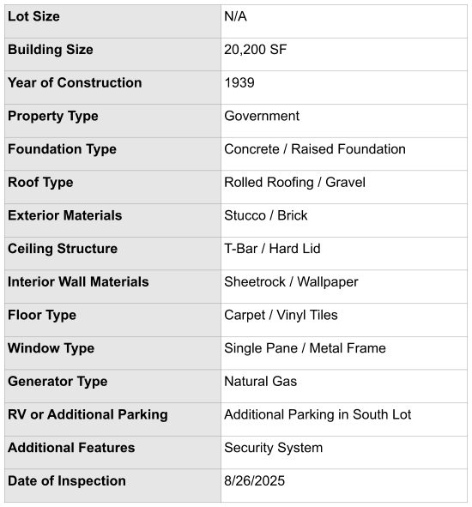
BUILDING DATA
EXECUTIVE SUMMARY
  The facility shows signs of aging with issues across site, interior, roofing, plumbing, electrical, and HVAC systems.
  High-priority concerns include: roof replacement, drainage improvements, HVAC upgrades, and electrical safety hazards.
  Immediate attention should be given to safety risks (exposed wiring, damaged steps, drainage problems).
  Capital improvements such as HVAC replacement and roof work are projected within the next 5 years.
LIMITATIONS
  Inspection is visual only; hidden or inaccessible areas were not evaluated.
  No destructive testing (inside walls, underground, sealed systems) was conducted.
  Seasonal/weather conditions may affect observed conditions.
  Specialized systems (e.g., fire suppression, security, renewable energy) were outside the scope.
  Findings provide a snapshot on the day of inspection; not a guarantee of future performance.
Notes:
“Our Home Health Reports are like a medical check-up — but for your property. Instead of just listing problems, we provide a detailed roadmap to keep your home safe, efficient, and valuable.”
“We help homeowners prioritize repairs, spot efficiency upgrades, and budget with confidence. The value is long-term: lower costs, safer living, and a stronger return on investment.”

Slide 17
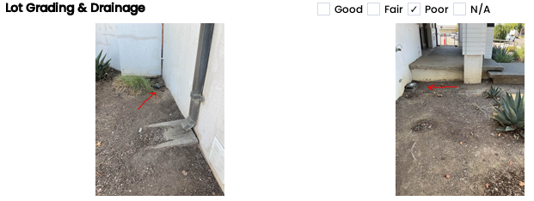
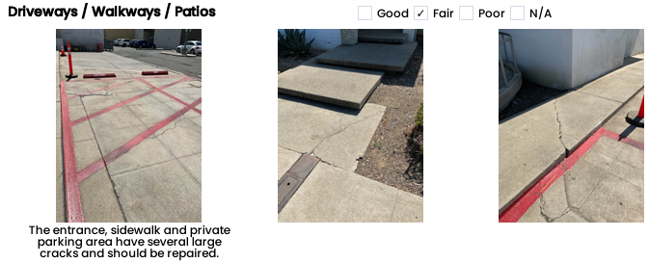
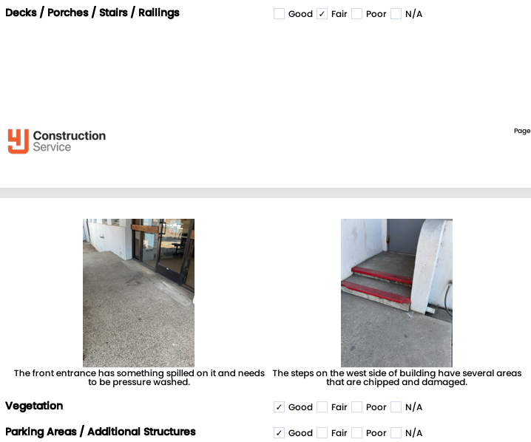
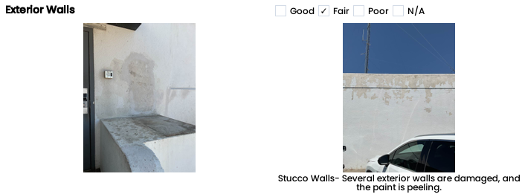
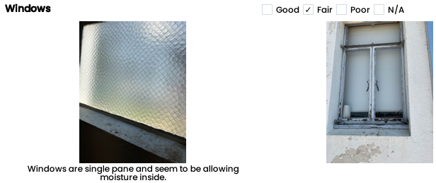
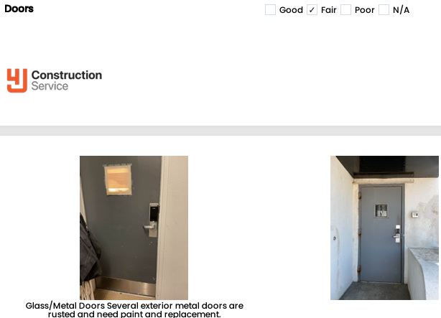
1. EXTERIOR
  Drainage on the north side allows water to pool against the building
  Sidewalk, driveway, and parking areas have cracks requiring repair
  Steps on the west side are chipped and damaged
Notes:
“Our Home Health Reports are like a medical check-up — but for your property. Instead of just listing problems, we provide a detailed roadmap to keep your home safe, efficient, and valuable.”
“We help homeowners prioritize repairs, spot efficiency upgrades, and budget with confidence. The value is long-term: lower costs, safer living, and a stronger return on investment.”

Slide 18
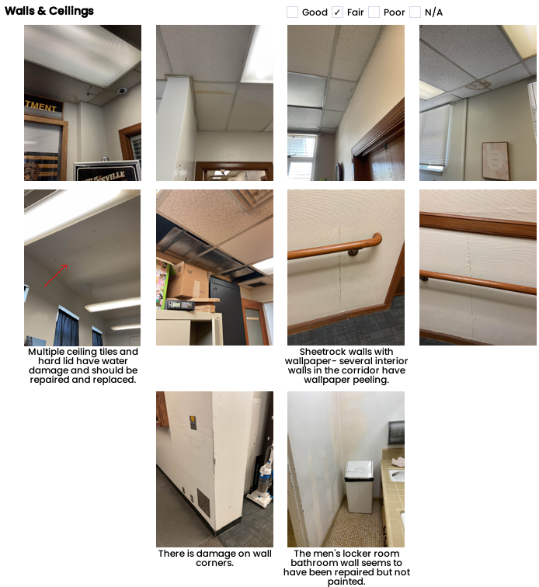
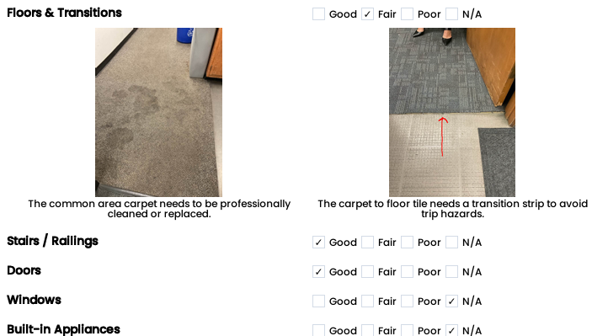
2. INTERIOR
  Ceiling tiles show water damage and need replacement
  Wallpaper peeling in corridors; wall corners damaged
  Carpet worn and needs replacement; trip hazard at transition strip
Notes:
“Our Home Health Reports are like a medical check-up — but for your property. Instead of just listing problems, we provide a detailed roadmap to keep your home safe, efficient, and valuable.”
“We help homeowners prioritize repairs, spot efficiency upgrades, and budget with confidence. The value is long-term: lower costs, safer living, and a stronger return on investment.”

Slide 19
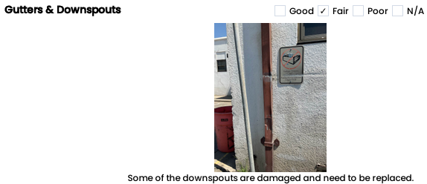
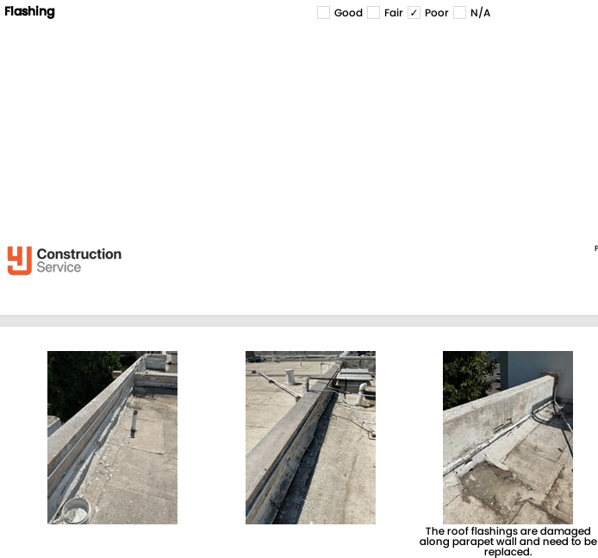
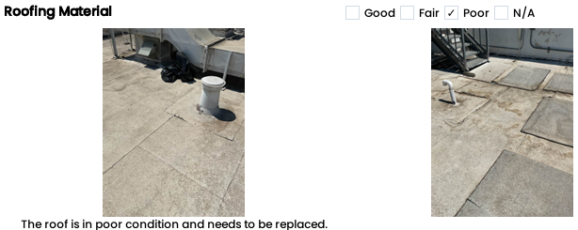
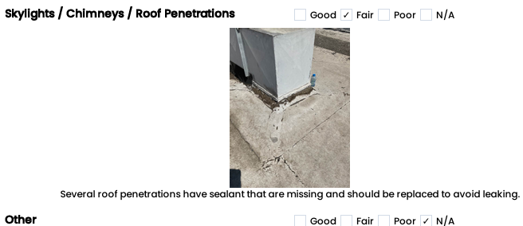
3. ROOFING
  Roof in poor condition, full replacement needed
  Downspouts damaged and flashing along parapet wall compromised
  Roof penetrations missing sealant, risk of leaks
Notes:
“Our Home Health Reports are like a medical check-up — but for your property. Instead of just listing problems, we provide a detailed roadmap to keep your home safe, efficient, and valuable.”
“We help homeowners prioritize repairs, spot efficiency upgrades, and budget with confidence. The value is long-term: lower costs, safer living, and a stronger return on investment.”

Slide 20
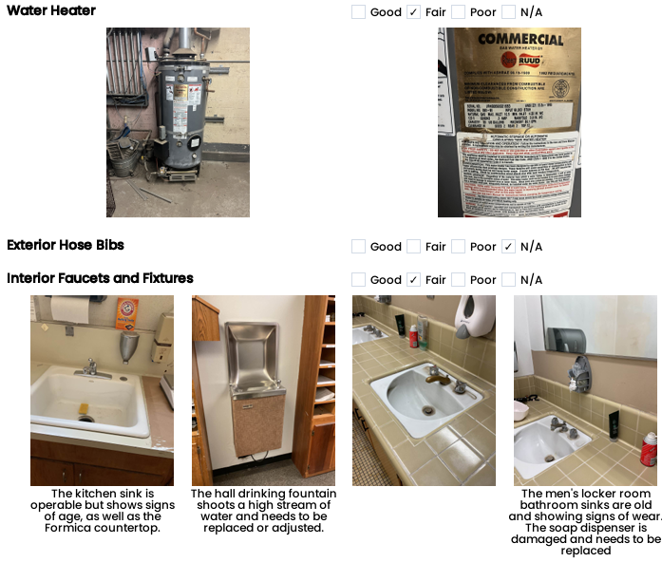
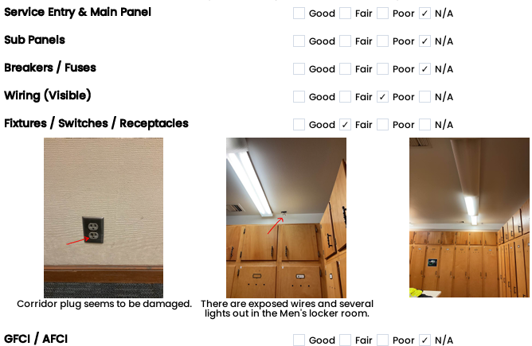
4. PLUMBING
  Aging sinks and fixtures in locker rooms and kitchen
  Soap dispenser damaged and needs replacement
  Drinking fountain shoots high stream, requires adjustment/replacement
5. ELECTRICAL
  Exposed wires in locker room, damaged outlets
  Corridor plug damaged, several lights not working
  Upgrades needed for safety (e.g., GFCI outlets)
Notes:
“Our Home Health Reports are like a medical check-up — but for your property. Instead of just listing problems, we provide a detailed roadmap to keep your home safe, efficient, and valuable.”
“We help homeowners prioritize repairs, spot efficiency upgrades, and budget with confidence. The value is long-term: lower costs, safer living, and a stronger return on investment.”

Slide 21
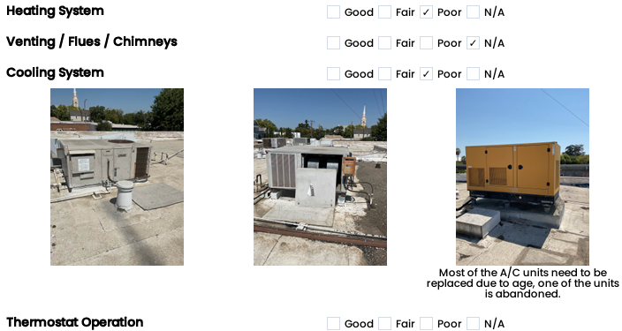
6. HEATING AND COOLING
7. INSULATION & VENTILATION
*Insulation was only inspected where visible; concealed areas and airflow were not evaluated.
8. FIREPLACES & FUEL-BURNING APPLIANCES
*Fireplace inspection was visual only; no testing, operation, or internal components were evaluated.
9. SAFETY & MISCELLANEOUS
  Most A/C units near end of life; one abandoned unit
  Phased HVAC replacements scheduled (2025–2029)
  Ventilation in attic and crawlspaces needs improvement
*Safety systems were only checked for presence and condition, not full code compliance or functionality.
Notes:
“Our Home Health Reports are like a medical check-up — but for your property. Instead of just listing problems, we provide a detailed roadmap to keep your home safe, efficient, and valuable.”
“We help homeowners prioritize repairs, spot efficiency upgrades, and budget with confidence. The value is long-term: lower costs, safer living, and a stronger return on investment.”

Slide 22
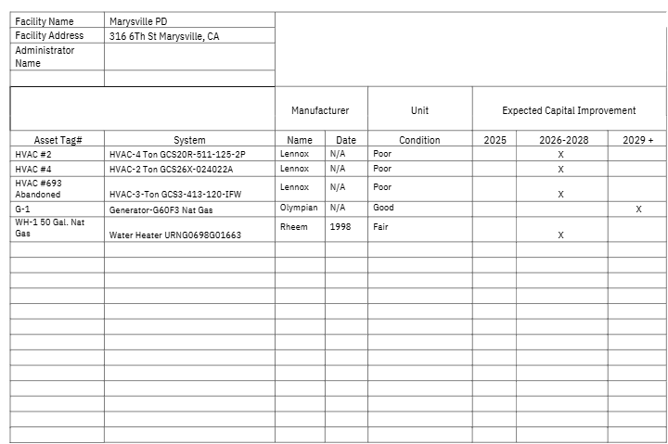
RECOMMENDATIONS SUMMARY
LOT ASSESSMENT
  Improve drainage on the north side of the building.
  Repair cracks in sidewalks, driveways, and parking areas.
  Replace/repair damaged steps at building entrances.
ELECTRICAL, A/C & VENTILATION
  Repair exposed wires and replace damaged outlets.
  Fix non-functioning lights in locker rooms and corridors.
  Add/upgrade GFCI outlets for safety compliance.
  Replace aging HVAC units (phased replacements from 2025–2029).
  Address abandoned HVAC unit.
  Improve ventilation in attic and crawlspaces for efficiency and safety.
Notes:
“Our Home Health Reports are like a medical check-up — but for your property. Instead of just listing problems, we provide a detailed roadmap to keep your home safe, efficient, and valuable.”
“We help homeowners prioritize repairs, spot efficiency upgrades, and budget with confidence. The value is long-term: lower costs, safer living, and a stronger return on investment.”

Slide 23
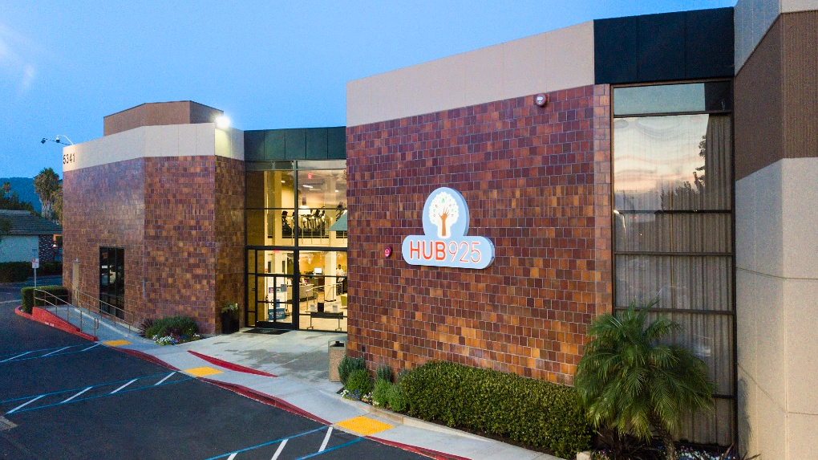
THE BENEFITS OF 4JCON’S EXPANDED SERVICES
  TRANSPARENCY AND TRUST IN PROPERTY DECISIONS
  LOWER LONG-TERM COSTS WITH PROACTIVE PLANNING
  INCREASED PROPERTY VALUE AND ASSET LIFE
  ENHANCED MARKETING AND ENGAGEMENT TOOLS
www.4jcon.com
Notes:
“These services align with our mission: to bring clarity and confidence to construction and property management. They help owners avoid surprises, reduce expenses, and make smarter long-term decisions.”

Slide 24
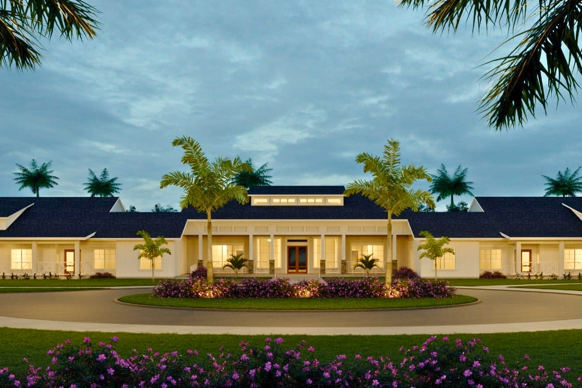



LET’S BUILD
SMARTER, SAFER, STRONGER TOGETHER
530-588-9366
jerry@4jcon.com
4JCON.com
SCHEDULE A CONSULTATION TODAY
Notes:
“We’re proud to keep innovating for our clients. These new services are not just add-ons — they’re strategic tools that create long-term value. We’d love to talk with you about how they can benefit your property or project.”

